Slide 1
Real Time Piano Test
Angular

Slide 2
Written in: Angular 2, Javascipt, Node, bootstrap,
Howler.js
Falls back to HTML5
Web audio library
Adds 3D spatial sounds
No outside dependencies
Very light-7kb

Slide 3
Angular 2
Type-Script based
Open source
Web Platform
Javascript framework
Main Feature:
Component based approach - Components help to build the applications into many modules. This helps in better maintaining the application over a period of time.
Earlier versions had controllers
Services − Services are a set of code that can be shared by different components of an application. So for example if you had a data component that picked data from a database, you could have it as a shared service that could be used across multiple applications.

Slide 4
Data Binding
Angular JS supported two-way binding
Removed from Angular 2
Suppose you have a class with a property that has a type and value
Export class className{
Property: propertyType: value;}
We can bind it in our html tag by using:
<html tag html property=‘property’ />

Slide 5
Components in our project
App component
Note Canvas
Piano
ScoreTracker

Slide 6
App Component
Renders all components
Integrates everything
Global Object: Score- used to pass user input to actual functions and for comparisons.

Slide 7
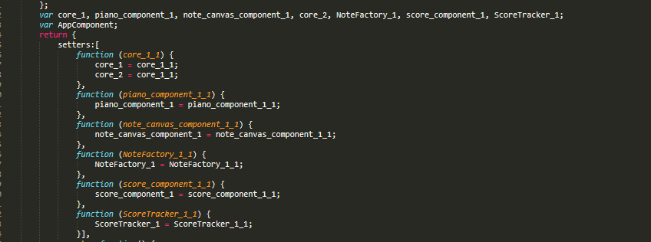
App

Slide 8
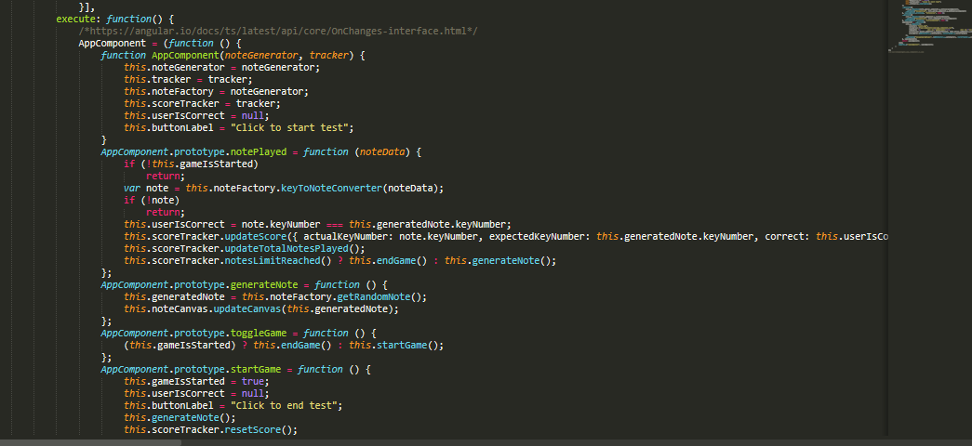
APP

Slide 9
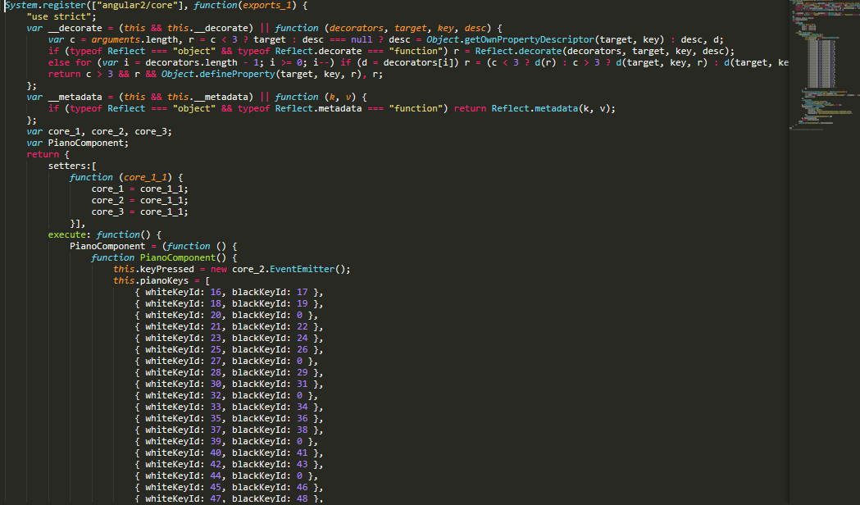
Piano

Slide 10
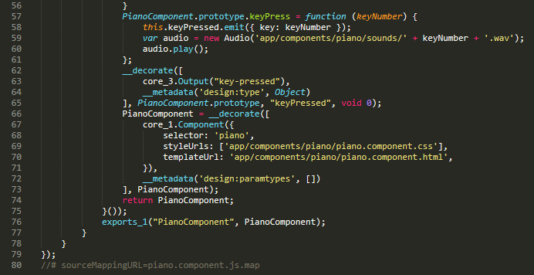
Piano

Slide 11
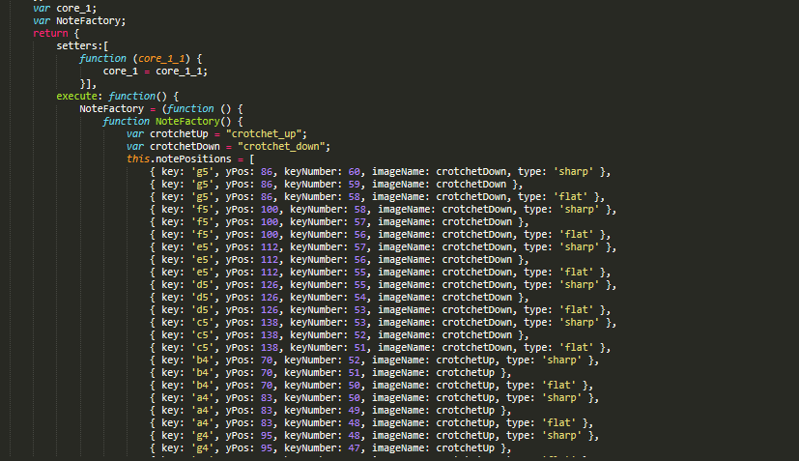
Note Factory

Slide 12
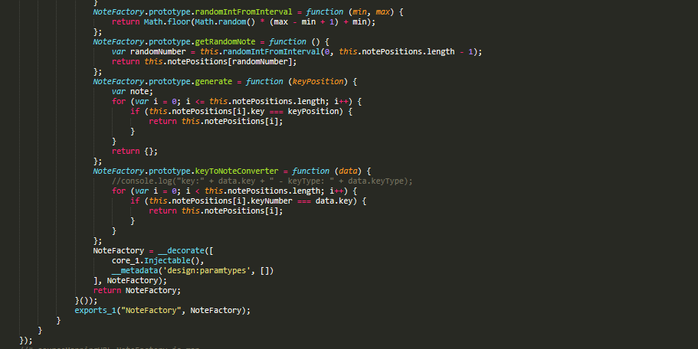
Note Factory

Slide 13
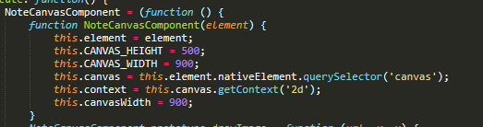
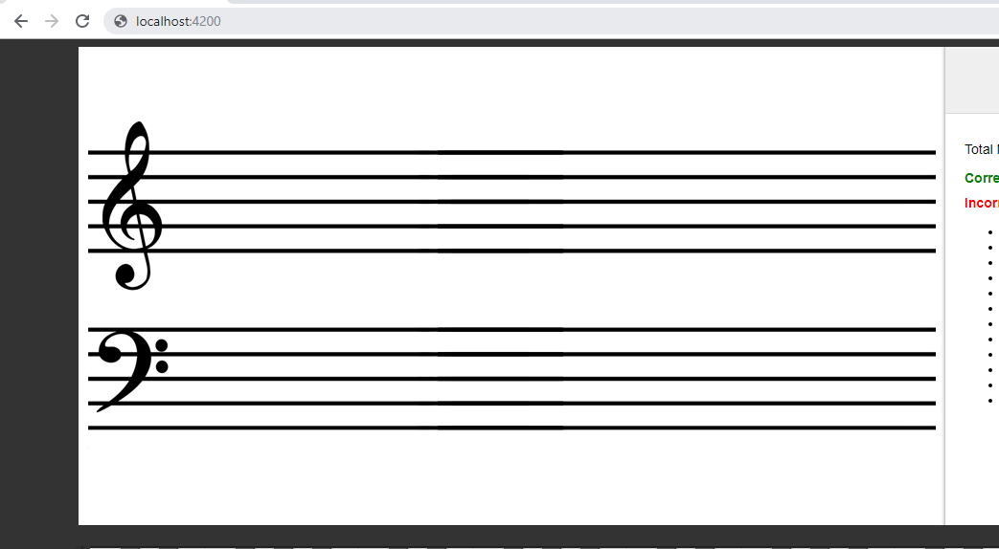
Note Canvas

Slide 14
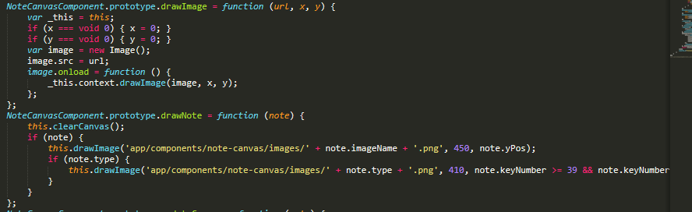
Note Canvas

Slide 15
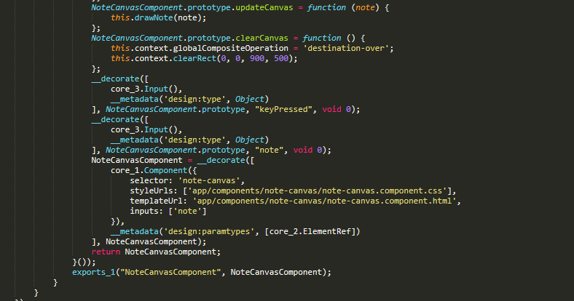
Note-Canvas

Slide 16
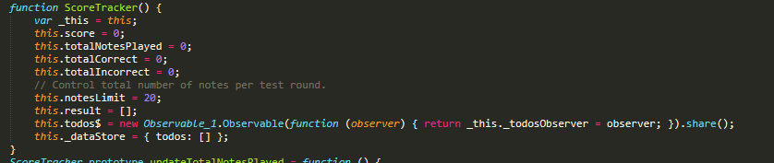
Score Tracker

Slide 17

Score Tracker

Slide 18
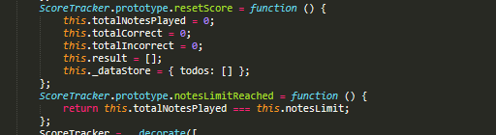
Score Tracker

Slide 19
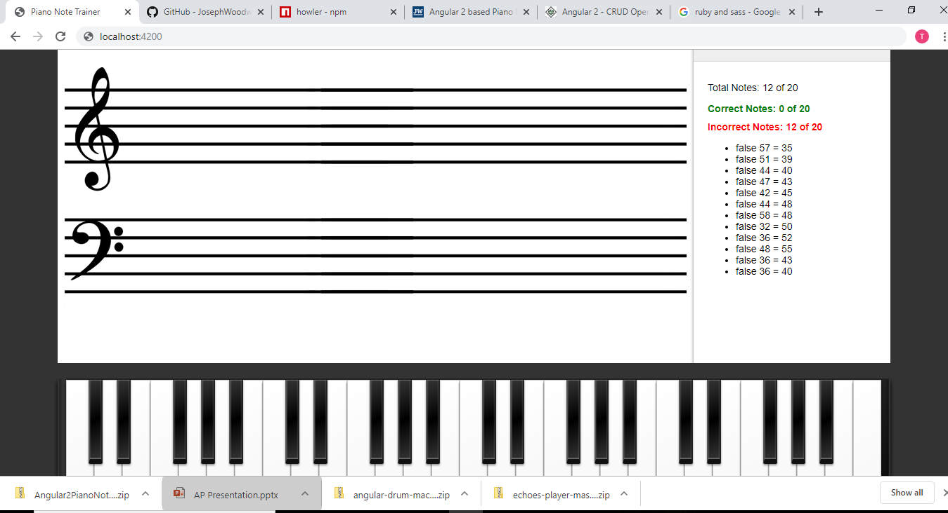
Output:

Slide 20
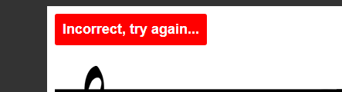
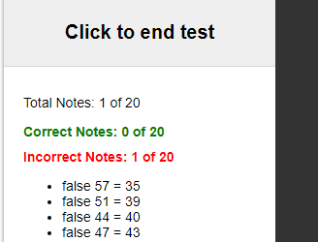
Output Incorrect

Slide 21
Problems
Ruby and Sass
Angular Installation
Needed shell scripting
Shell scripting caused errors

Slide 22
THANK YOU!

